Slide 1
Welcome
To
Project - 6
Pharmaceutical Sales prediction across multiple stores
Name – Mohd Jubair Khan
Date – 30 – 08 - 2024

Slide 2
Abstract
The pharmaceutical industry relies heavily on accurate sales forecasting to ensure optimal inventory management, reduce waste, and meet customer demands across various locations. This project focuses on developing a predictive model for pharmaceutical sales across multiple stores, leveraging historical sales data, store-specific features, and external factors such as holidays and promotions. By employing machine learning techniques, the model aims to predict future sales with high accuracy, enabling better decision-making for inventory allocation and promotion strategies.
The analysis begins with extensive exploratory data analysis (EDA) to identify key patterns and relationships within the data. Feature engineering is performed to extract meaningful variables that contribute to the predictive power of the model. Various machine learning algorithms, including linear regression, decision trees, and ensemble methods like random forests, are evaluated to determine the most effective approach for sales prediction.
To ensure the model's robustness, hyper parameter tuning and cross-validation techniques are applied. The final model is deployed through a user-friendly web application, allowing store managers to input relevant data and receive real-time sales forecasts. This tool not only aids in managing day-to-day operations but also supports strategic planning by providing insights into sales trends and the impact of promotions.

Slide 3
Content
1. Introduction
2. Objectives
3. Methods
4. Results
5. Conclusions
Chapter - 1
1. Introduction
In the pharmaceutical retail industry, accurate sales forecasting is critical for maintaining the delicate balance between supply and demand. Ensuring that stores are adequately stocked to meet customer needs while minimizing overstock and waste is a complex challenge, especially when dealing with multiple locations with varying customer bases and purchasing patterns. As the industry continues to grow, so does the need for more sophisticated and reliable methods to predict sales trends and optimize inventory management.
This project aims to develop a predictive model for pharmaceutical sales across multiple stores, utilizing historical sales data, store-specific features, and external factors such as promotions, holidays, and regional demographics. Traditional sales forecasting methods often fall short in accounting for the multitude of variables that influence consumer behavior in the pharmaceutical sector.

Slide 4
Chapter - 2
2. Objectives:
To develop an accurate predictive model for pharmaceutical sales across multiple stores using historical sales data and store-specific features.
To enhance inventory management and reduce wastage by forecasting sales trends and optimizing stock levels. To evaluate the impact of external factors such as promotions and holidays on sales and incorporate these into the predictive model.
1.Data Collection: The data used in this project was collected from various sources to ensure a comprehensive understanding of pharmaceutical sales patterns across multiple stores. The primary dataset consists of historical sales data obtained directly from the internal databases of a major pharmaceutical retail chain. This dataset includes detailed information on daily sales figures, store locations, product categories, and customer demographics.
2.Data Cleaning and Preprocessing:

Slide 5
3.Exploratory Data Analysis (EDA): Analyzing the dataset to identify key features, uncover patterns, and visualize trends that impact house prices.
4.Feature Engineering: Creating new features based on domain knowledge and statistical methods to enhance the predictive power of the model.
5.Model Development and Evaluation: Building, training, and evaluating several machine learning models, including linear regression, decision trees, and random forests, to identify the best-performing model.
6.Model Deployment: Developing a user-friendly web application using Streamlit to make the prediction model accessible for user behaviour estimation.

Slide 6
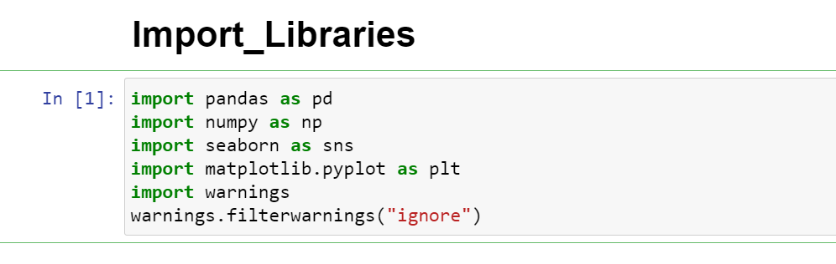
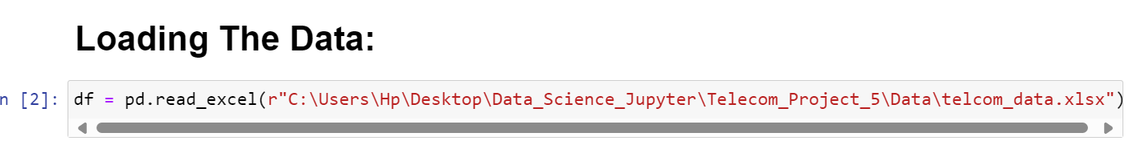
Chapter - 3
3. Methods
(i). Loading the Data:
To load the real estate pricing dataset into a Pandas DataFrame, Load the dataset provided in a CSV or Excel format into a Pandas DataFrame to facilitate easy manipulation and analysis. Using Python Pandas Library.

Slide 7
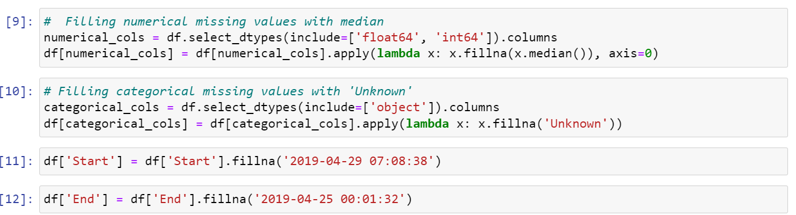
(ii). Cleaning the Data:
Cleaning the data is an essential step in the data analysis process, particularly for User Analytics in the Telecommunication Industry - Overview. It involves preparing the dataset by addressing missing values, removing duplicate entries, and fixing any anomalies or inconsistencies. This ensures that the data is accurate and reliable for further analysis.
(a). Handling Missing Values:
Missing values can occur due to various reasons such as data entry errors or incomplete records. To handle missing values, you can:
Use isnull() method to identify missing values in the dataset.
Use fillna() method to replace missing values with appropriate values, such as the mean, median, or mode of the column.
Alternatively, you can use the dropna() method to remove rows with missing values if they are not critical for your analysis.

Slide 8
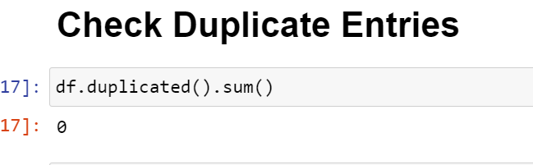
(b). Removing Duplicates:
Duplicate entries can skew the analysis results. To remove duplicates, you can:
Use the duplicated() method to identify duplicate rows in the dataset.
Use the drop_duplicated() method to remove duplicate rows and keep only unique entries.

Slide 9
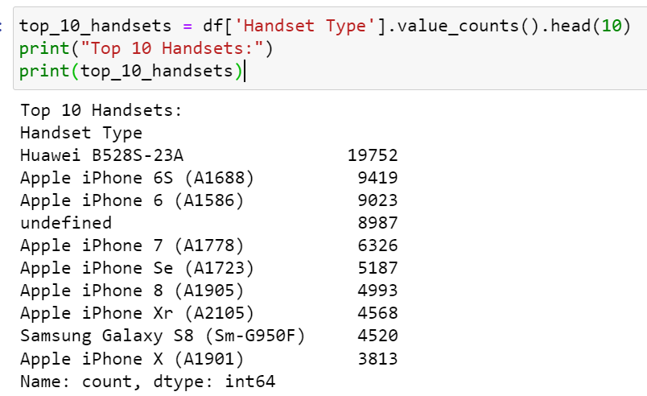
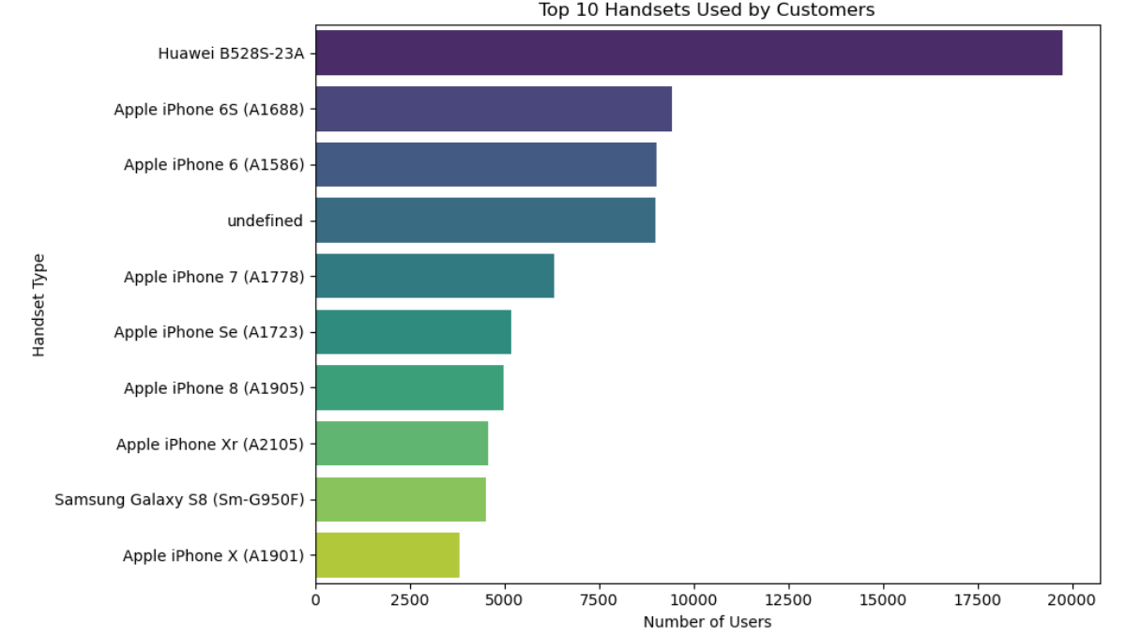
Task 1 - User Overview Analysis
1. Identify the top 10 handsets used by the customers:

Slide 10
Explanation:
1. Huawei B528S-23A is the most popular handset with 19,752 users.
2. Apple devices dominate the list with seven out of the top ten handsets.
3. Samsung Galaxy S8 (SM-G950F) is also popular with 4,520 users.
4. The presence of an undefined handset indicates a need for data cleaning.
Recommendations:
1. Targeted Marketing for Apple: Focus on upgrade promotions for users with older iPhone models. Highlight the features of newer iPhone models to encourage upgrades.
2. Competitive Strategies for Samsung: Promote the latest Samsung models, highlighting their advanced features. Implement loyalty programs for existing Samsung users.
3. Expansion Strategies for Huawei: Promote other Huawei models and introduce new devices targeting the same user base. Address the undefined handsets to convert those users into identifiable handsets for better analysis.

Slide 11
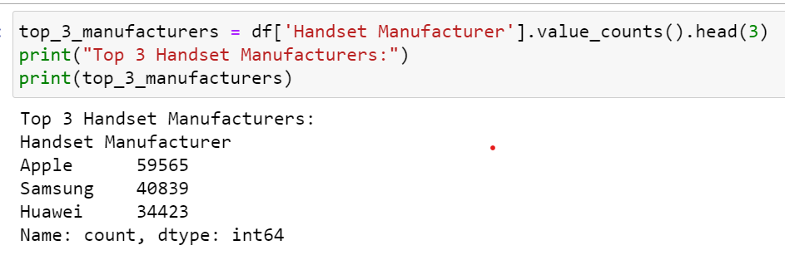
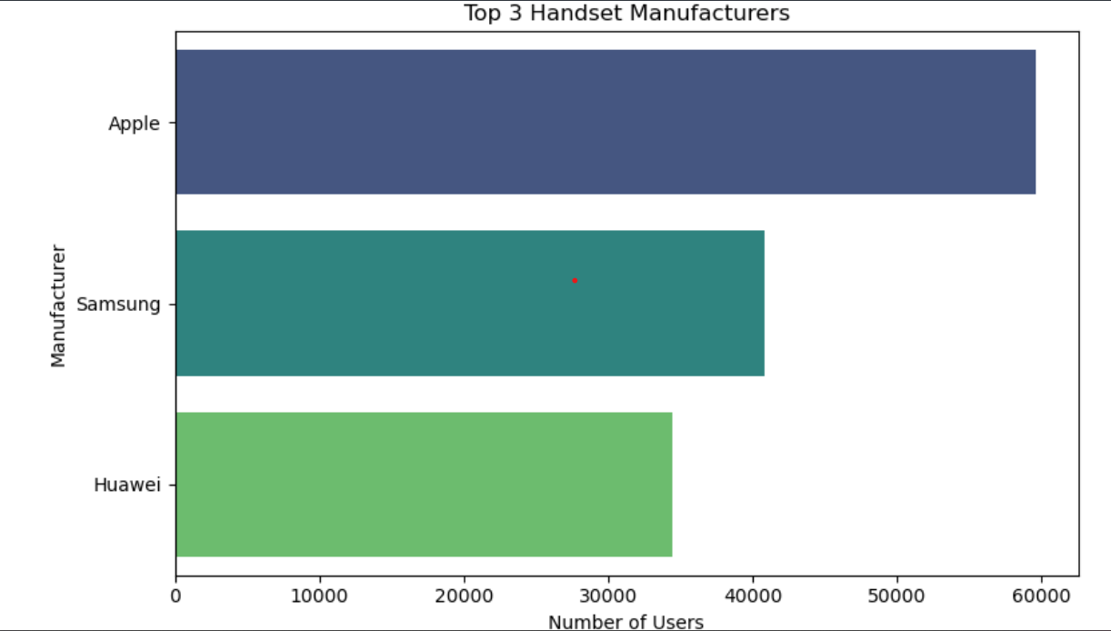
2. Identify the top 3 handset manufacturers:

Slide 12
Detailed Interpretation:
Top 3 Handset Manufacturers:
1. Apple: 59,565 users
2. Samsung: 40,839 users
3. Huawei: 34,423 users
** Sample Interpretation:
From the analysis, we observe that the most popular handsets are predominantly from Apple, Samsung, and Huawei. The top 3 manufacturers account for a significant portion of the market share:
Apple leads with 42.3% of the user base among the top 3 manufacturers.
2. Samsung follows with 29.0%.
3. Huawei holds 24.5%.
Recommendations:
1.For Apple: Focus on Top Models: Apple's top handsets should be highlighted in marketing campaigns. Emphasize their unique features and benefits to maintain and grow their user base. Loyalty Programs: Introduce loyalty programs and trade-in options to retain existing customers and attract new ones.
2.For Samsung: Innovative Features: Highlight innovative features in Samsung's top models to differentiate them from competitors. Promotional Offers: Consider promotional offers and bundles to attract customers who might be considering switching from other brands.
3.For Huawei: Market Penetration: Increase market penetration by targeting regions or demographics where Huawei is less dominant. Customer Support: Strengthen customer support and service options to enhance customer satisfaction and loyalty.

Slide 13
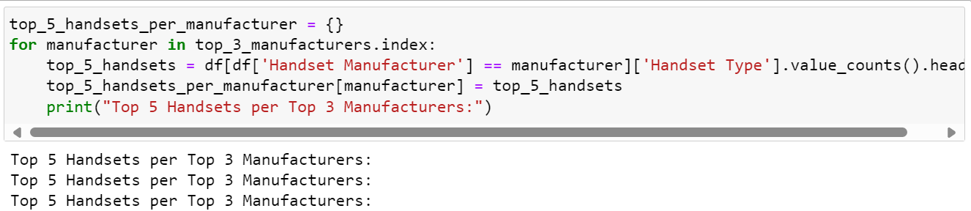
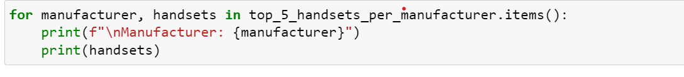
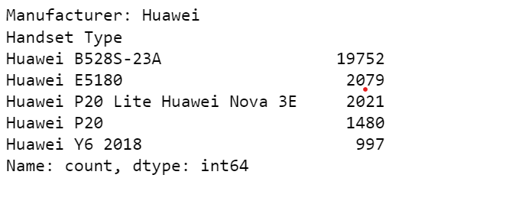
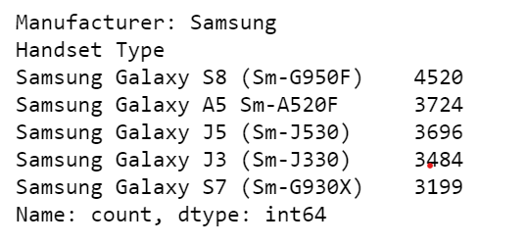
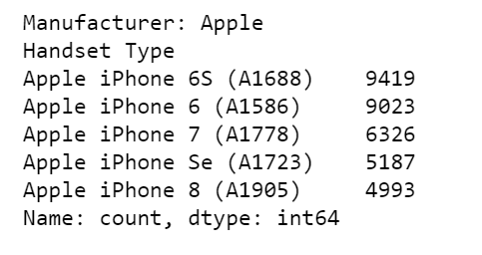
3. Identify the top 5 handsets per top 3 handset manufacturer:

Slide 14
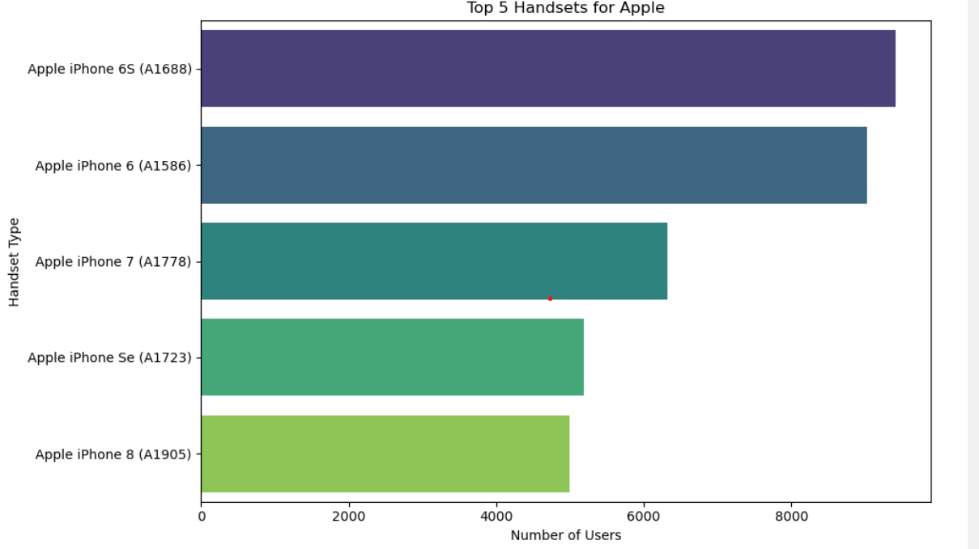
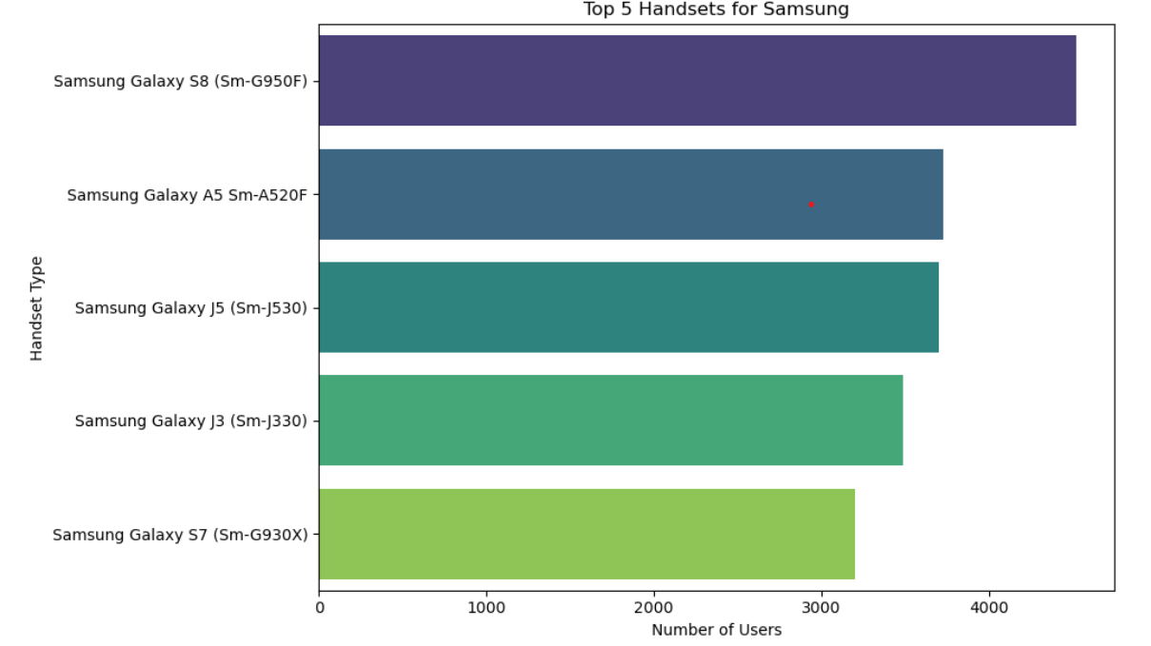

Slide 15
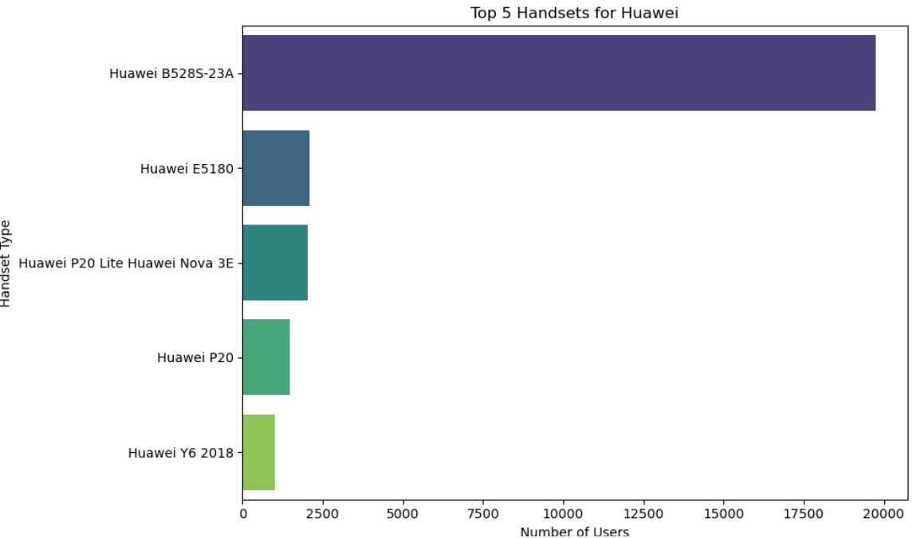
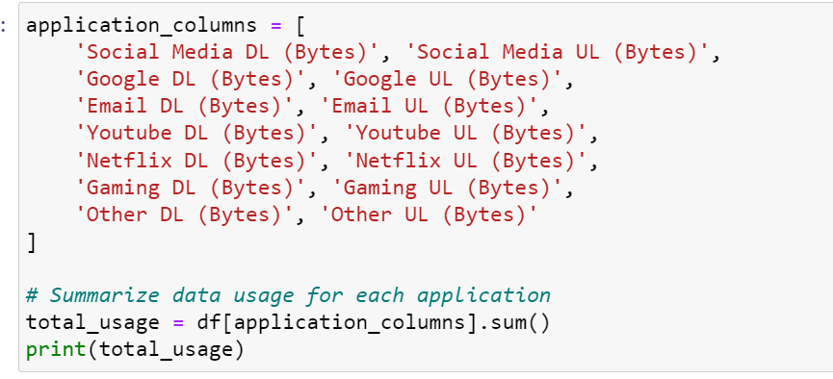
Summing the data usage for each application

Slide 16
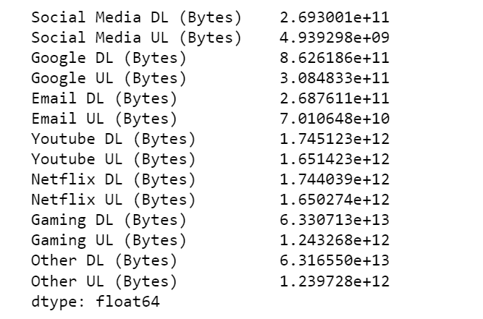
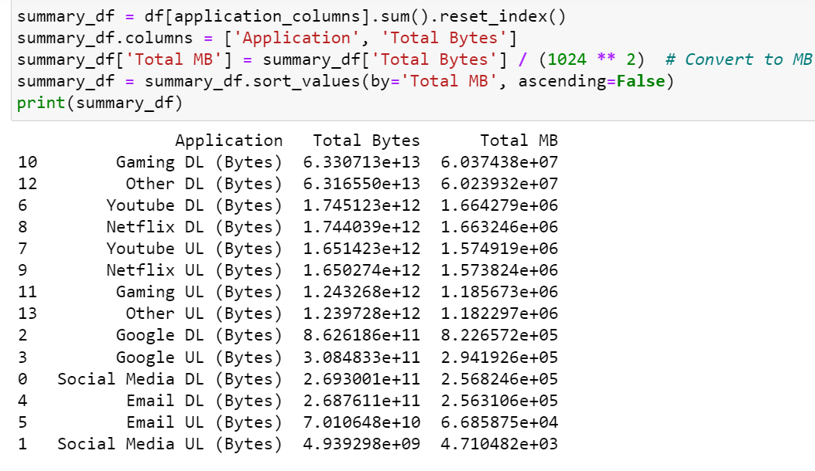

Slide 17
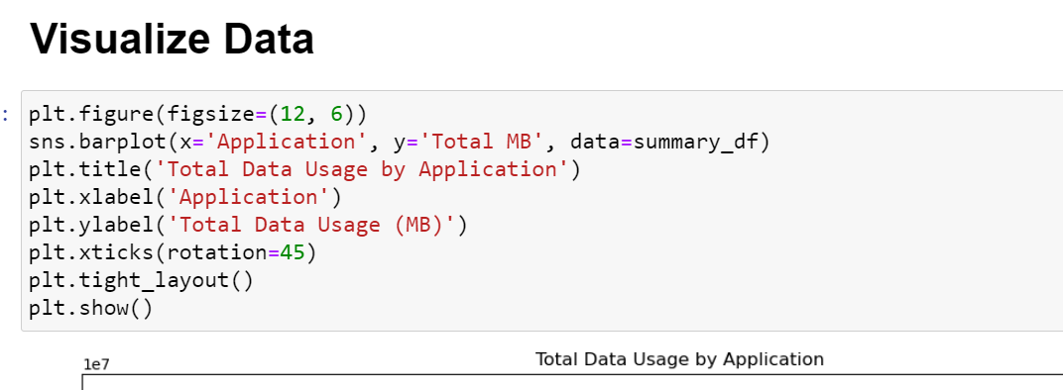
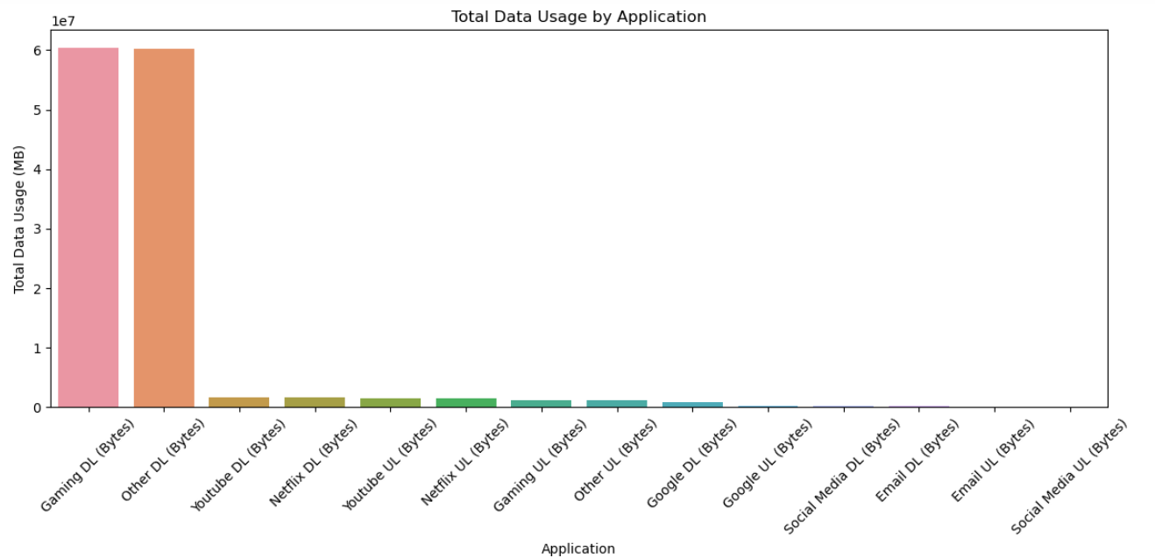

Slide 18
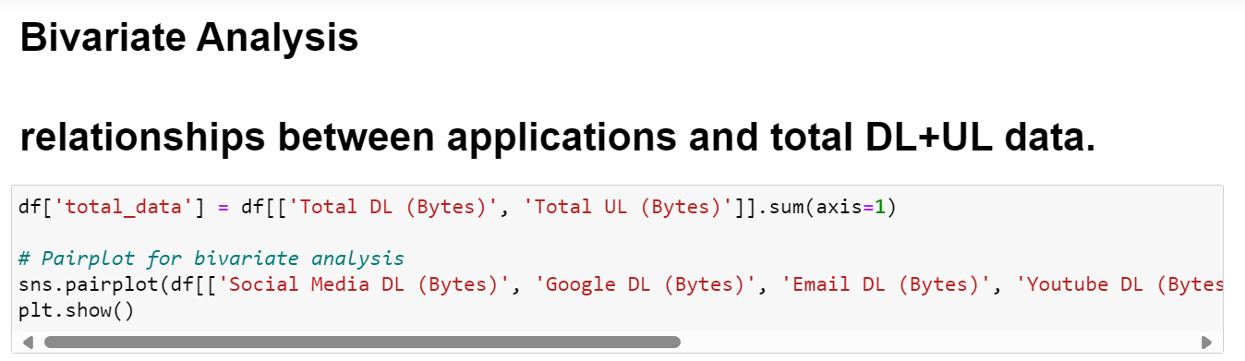
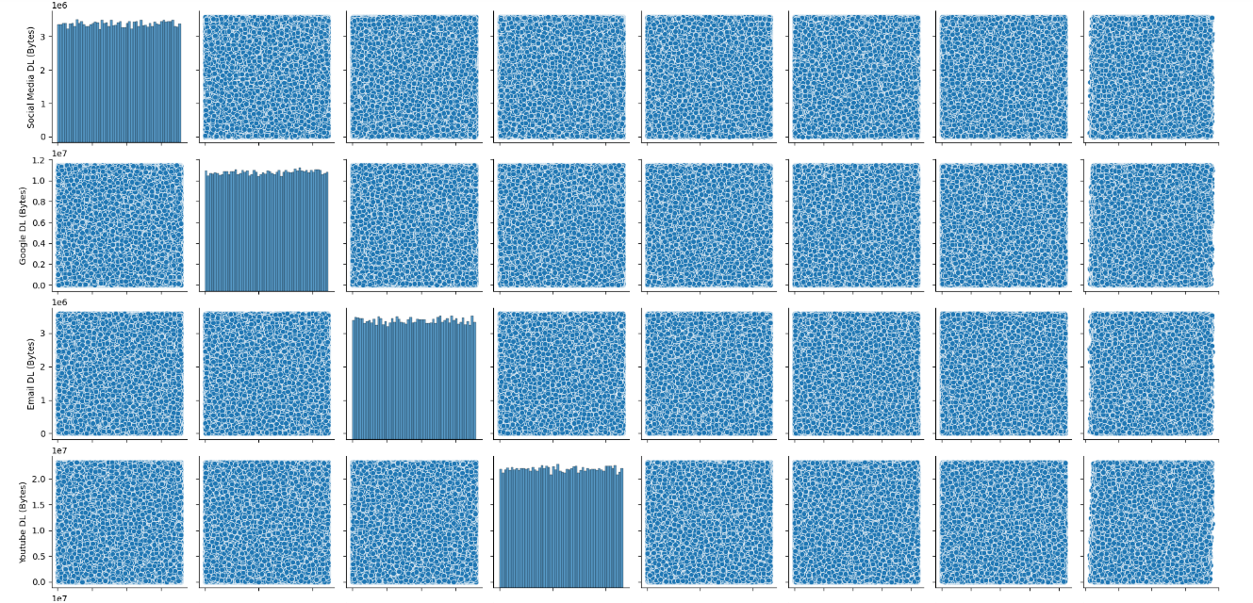

Slide 19
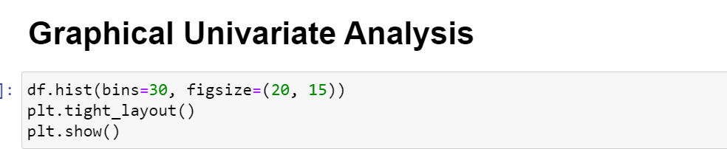
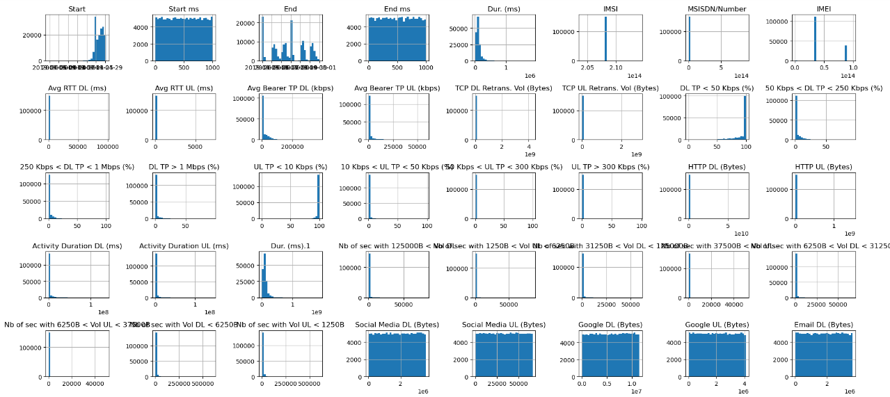

Slide 20
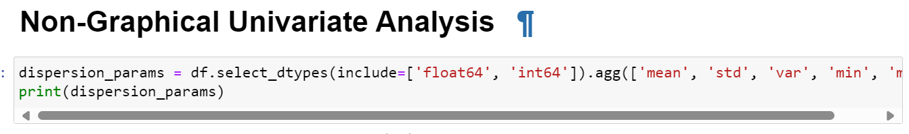
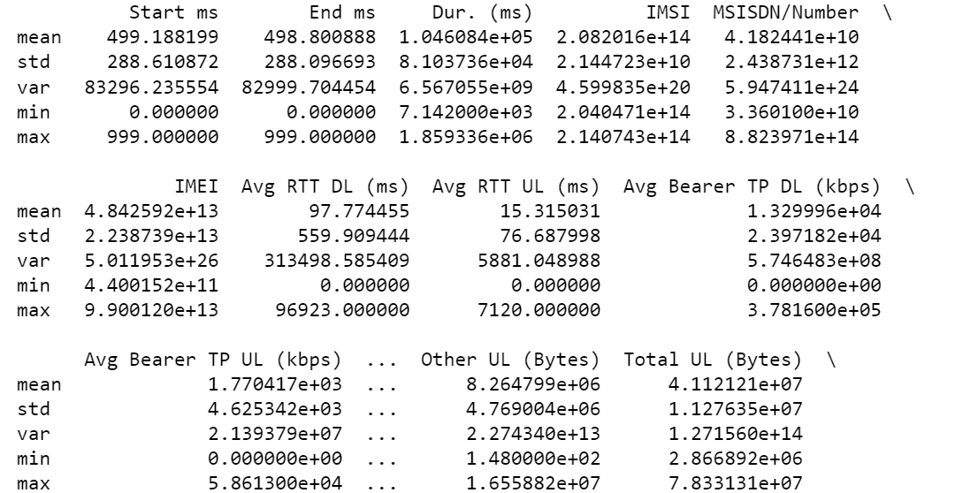

Slide 21
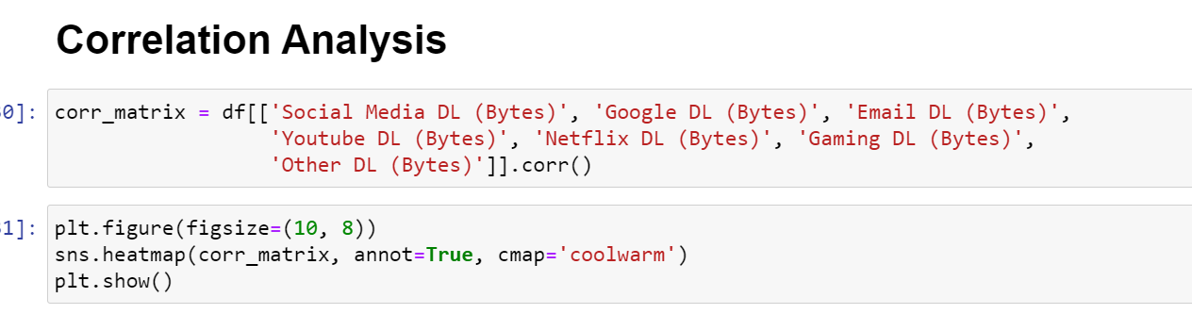
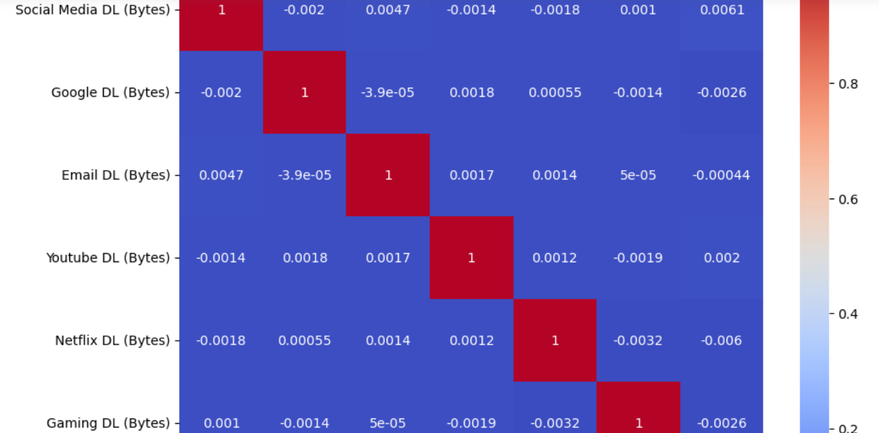

Slide 22
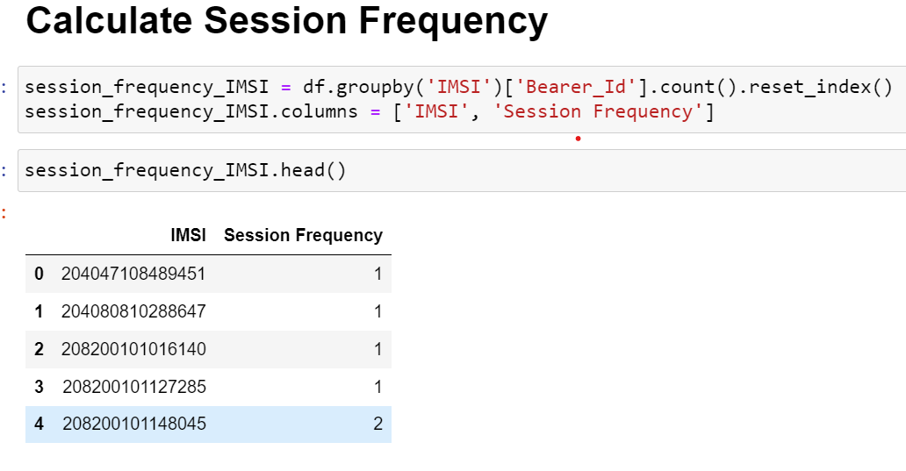
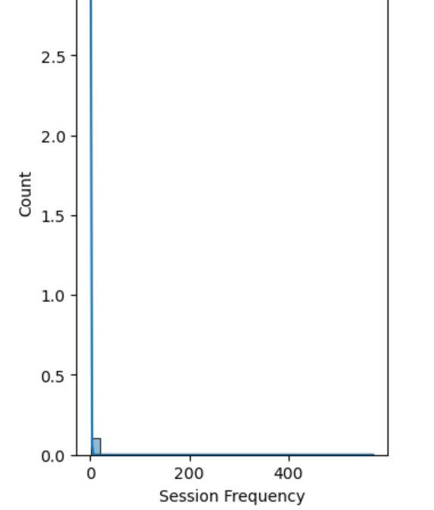
Task 2 - User Engagement Analysis

Slide 23
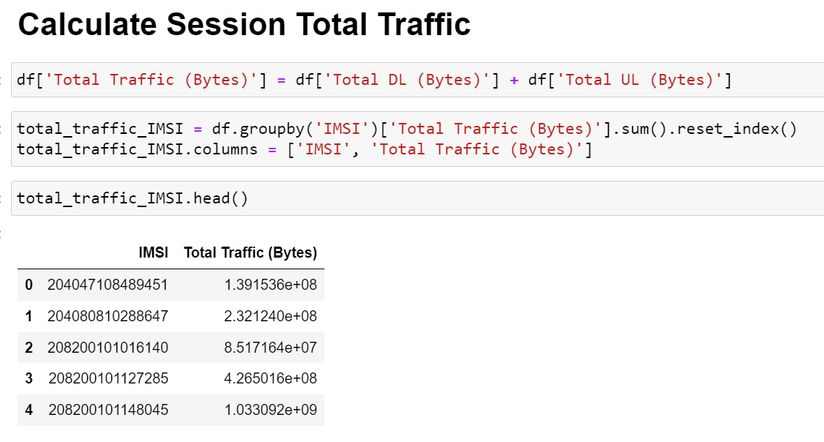
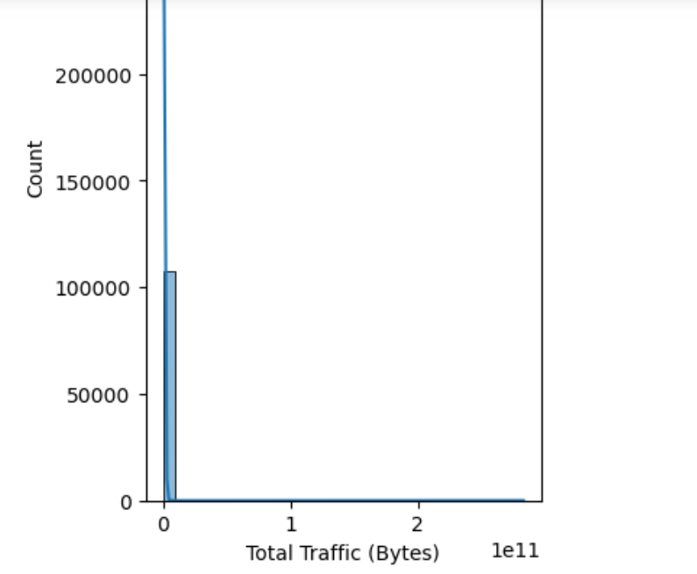

Slide 24
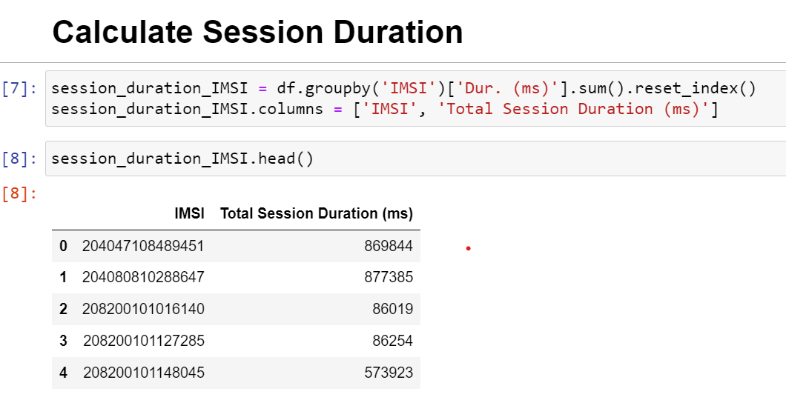
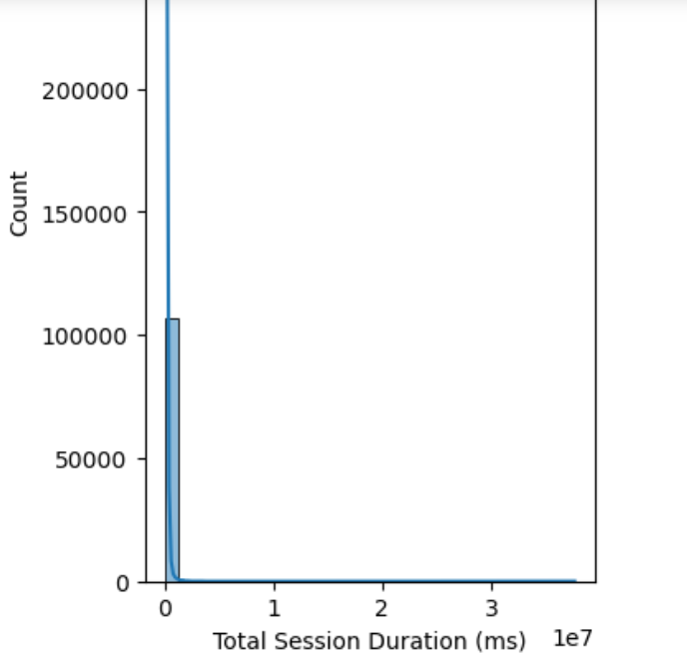

Slide 25
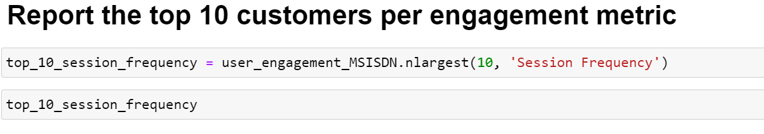
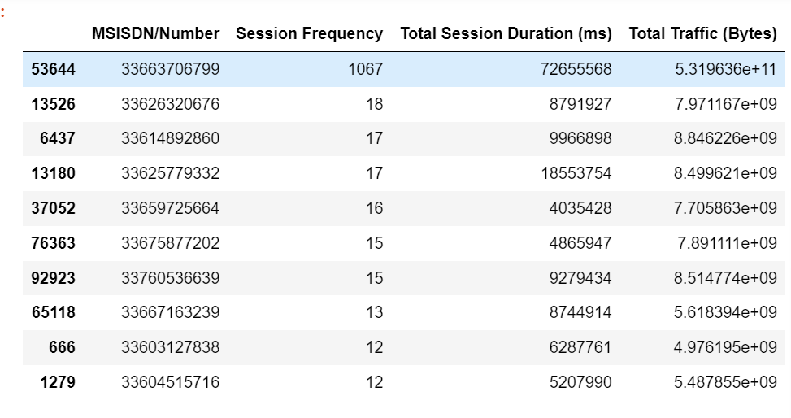

Slide 26
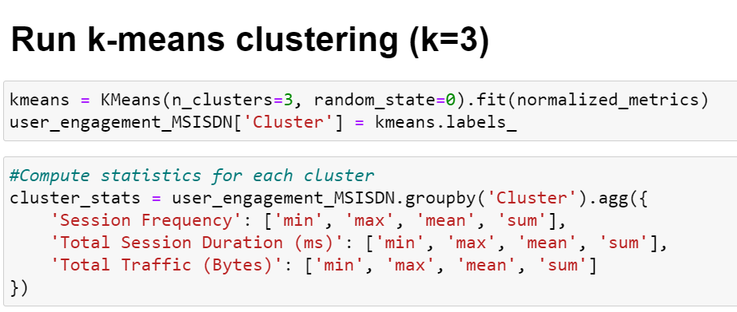
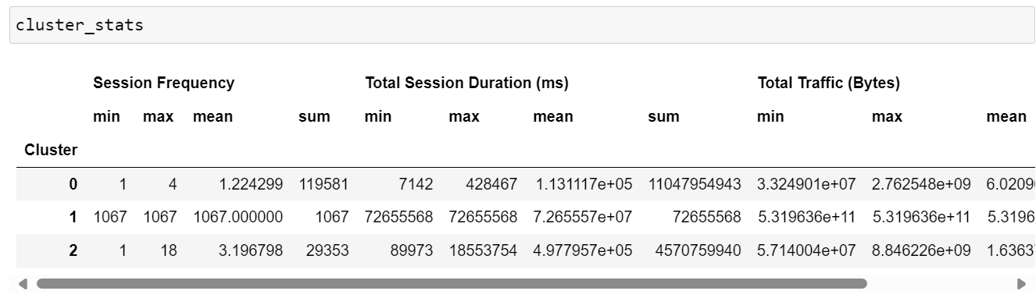

Slide 27
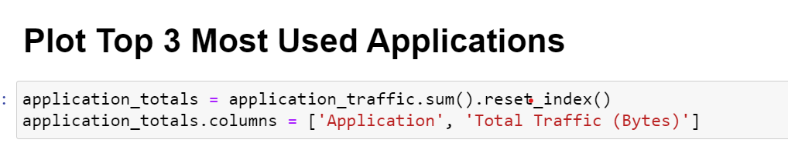
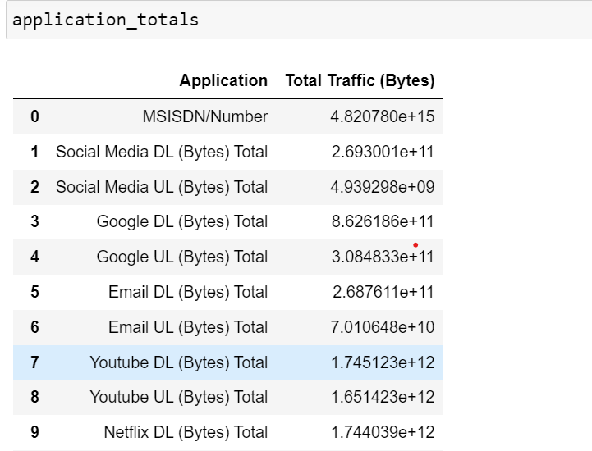

Slide 28
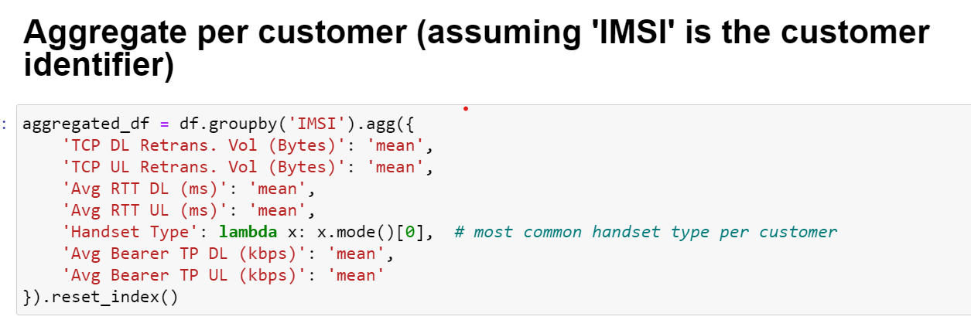
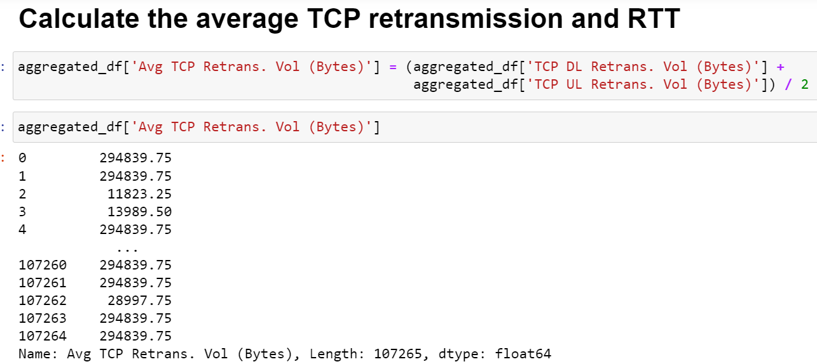
Task 3 - Experience Analytics

Slide 29
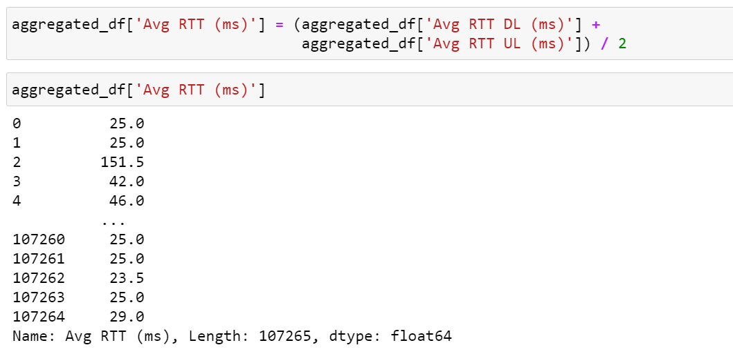
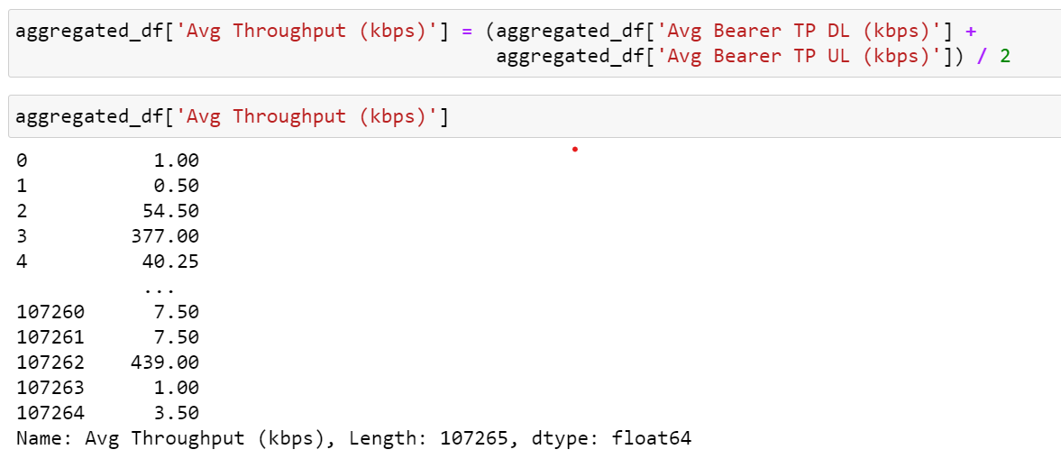

Slide 30
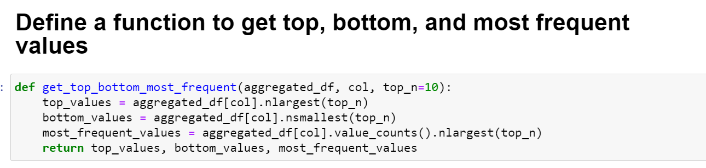
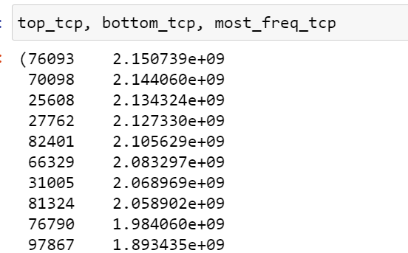
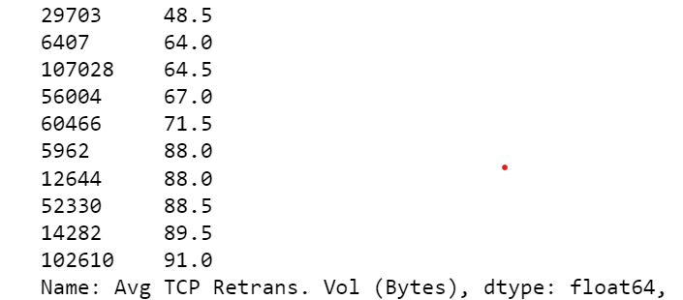
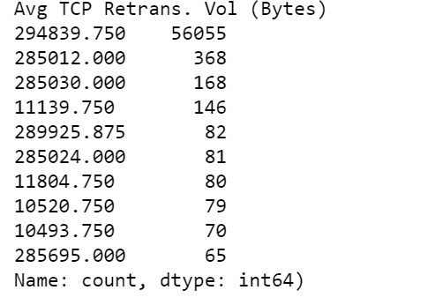

Slide 31
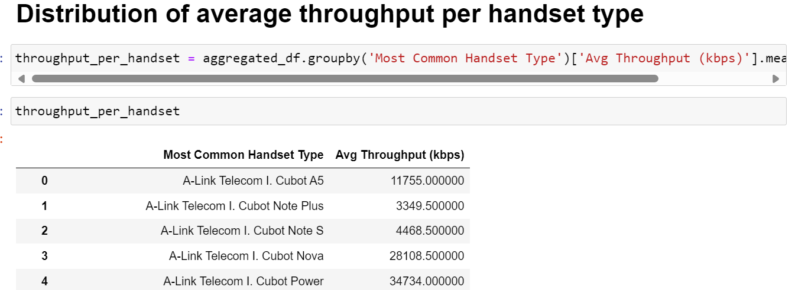


Slide 32


Slide 33



Slide 34


Slide 35



Slide 36

Task 4 - Satisfaction Analysis

Slide 37



Slide 38


Slide 39



Slide 40



Slide 41


Slide 42



Slide 43


Slide 44
Chapter - 4
4. Results:
Limitations:
– Some of the columns in the datasets have large percentages of missing values, thus cannot be analysed.
– The data has no timestamp. It might contain old records which might give a false overview of the current situation.
– The analysis is focused only on the user leaving out potential insights that could be obtained from other aspects like handsets-analysis.
– The call detail record (voice channel) is ignored and more focus is put on data sessions detail record.

Slide 45
Recommendations:
– The company has some weaknesses and strengths based on the analysis. It is worth buying with some changes to be made:
● The handset types should be stocked depending on their number of users.
● More gaming handsets should be introduced given that majority of traffic is as a result of games.
● More features should be added to the existing gaming apps to increase sessions traffic.
● Handsets with a wide variety of applications should be introduced to in order to capture the attention of less engaged users.
● Poor performing handsets based on RTT, TP and TCP values should be replaced by the excellent performers.

Slide 46
Chapter - 5
5. Conclusions:
After conducting an extensive analysis of TellCo’s user data, we have identified several key insights and opportunities for growth:
1.User Overview:
The top 10 handsets and top 3 manufacturers dominate the market. Marketing strategies should target these popular devices to maximize reach.
The aggregated user behavior data highlights significant usage patterns across various applications, providing a clear picture of customer preferences.
2.User Engagement:
High engagement metrics were observed for users frequently accessing social media, YouTube, and Netflix. Enhancing network resources for these applications could improve user satisfaction and retention.
K-means clustering revealed distinct user segments based on engagement levels, allowing for targeted marketing and resource allocation.

Slide 47
3.User Experience:
Average throughput and TCP retransmission rates vary across handset types, indicating potential areas for network optimization.
Clustering users based on experience metrics identified groups with specific needs and challenges, guiding network improvement efforts.
4.User Satisfaction:
Combining engagement and experience scores provided a comprehensive satisfaction score. The regression model accurately predicted user satisfaction, aiding in proactive service improvements.
Clustering satisfaction scores identified distinct user groups, enabling tailored customer service strategies.

